Slide 1
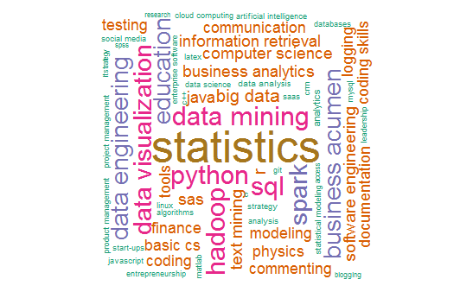
Data 607 - Project #3
Fall 2016
Project – Data Science Skills

Slide 2

Team Members
Names | Roles | Responsibilities
Bin Lin | Data Analyst | Analyse and visualize the data
Jose Zuniga | Data Architect | Extract ,Transform and Load data into mySQL database
Judd Anderman | Programmer | Scraping LinkedIn profile URLs from kdnuggets.com, skills from linkedin.com, job listings via Dice.com API; cleaning
Ka Man Chan | Programmer | Web scraping from kdnuggets.com/API from Dice.com; Presentation setup
Marco Siqueira Campos | Data Analyst | Analyze and visualize the data
Scott Ogden | Data Analyst | Analyze and visualize the data
Sharon Morris | Project Manager | Make sure project finish on time
Talha Muhammad | Presentation | Added to presentation and organization
Yefei Li | Data Integration | Finalize all required documents and execute the integrations of different resources

Slide 3
Workflow
Data Collection
Data Cleaning
Data Analysis
Presentation
Results
Judd Anderman
Ka Man Chan
Jose Zuniga
Judd Anderman
Marco Siqueira Campos
Scott Ogden
Ka Man Chan
Talha Muhammad
All Team Members
Project Manager Sharon Morris

Slide 4

Brainstorm with Scientific Method
Question: What the most valued Data Science skills?
Which soft skills (collaborative, teamwork,..) are more important for Data Science leadership roles outside of technical skills?
Approach: We had a very layered approach checking against multiple sources
The Skills: Scraped top skills listed in KDNuggets
The Market: Using Dice queried job postings and identified skills
The Leaders: Identified skill listings for Data Science leaders in linkedin
We used all three data sets to gain a comprehensive picture of the most highly regarded data science skill sets

Slide 5

Data Collection
Which skills? Identified skills by scraping web data from kdnuggets.com
Mark Retrieved 80+ skills from 9 articles identifying data science skills
Skills
How are skills valued? Used API from Dice.com, querying skill set from kdnuggets and retrieved first 50 job postings for each skill
Skills
Which skills do Data Science leaders have? Scraped skills from Linkedin profiles of data science leaders ID’d by KDnuggets and LinkedIn
Retrieved ~650 unique skills from 43 user profiles
Data Collection
Skills
Market
Leaders

Slide 6

Cleaning Data
LinkedIn profiles data was scraped from the relevant HTML text and attribute nodes, so relatively little cleaning necessary
Data frame columns containing non-ASCII characters identified using tools::showNonASCII(), then converted to ASCII encoding with non-convertible bytes replaced using iconv()
Unique skills obtained by matching character cases with tolower() and then using dplyr::distinct()
Notes:
encoding with non-convertible bytes replaced using iconv()

Slide 7
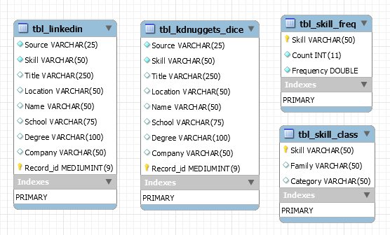
Database Structure
RMySQL
Disparate data
Primary Keys
Nulls
Union Query

Slide 8

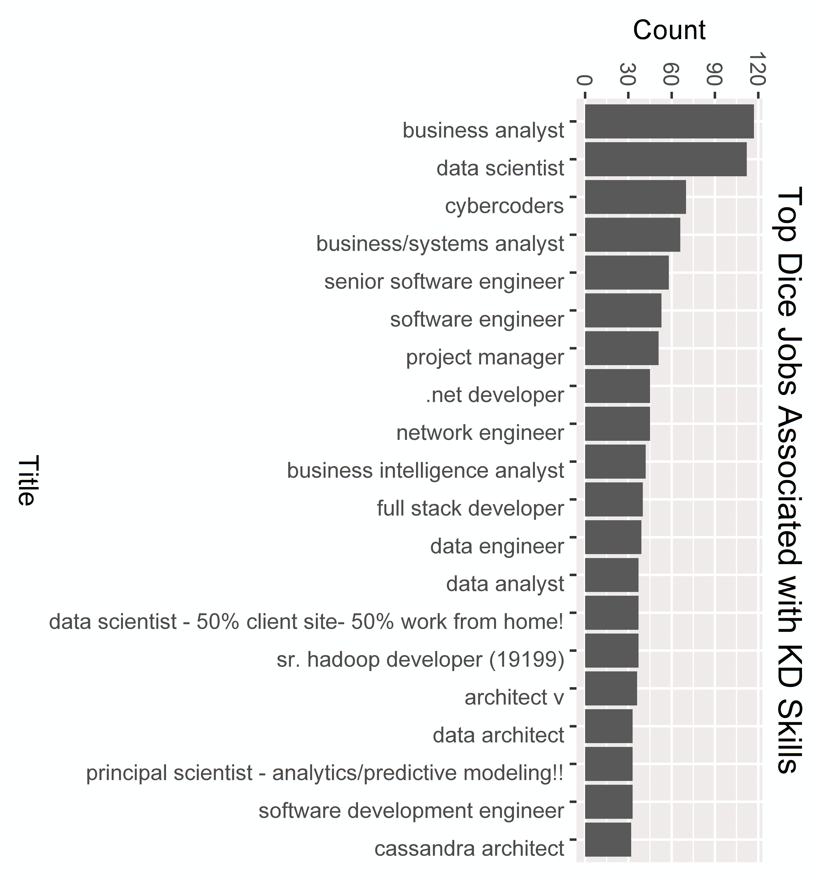
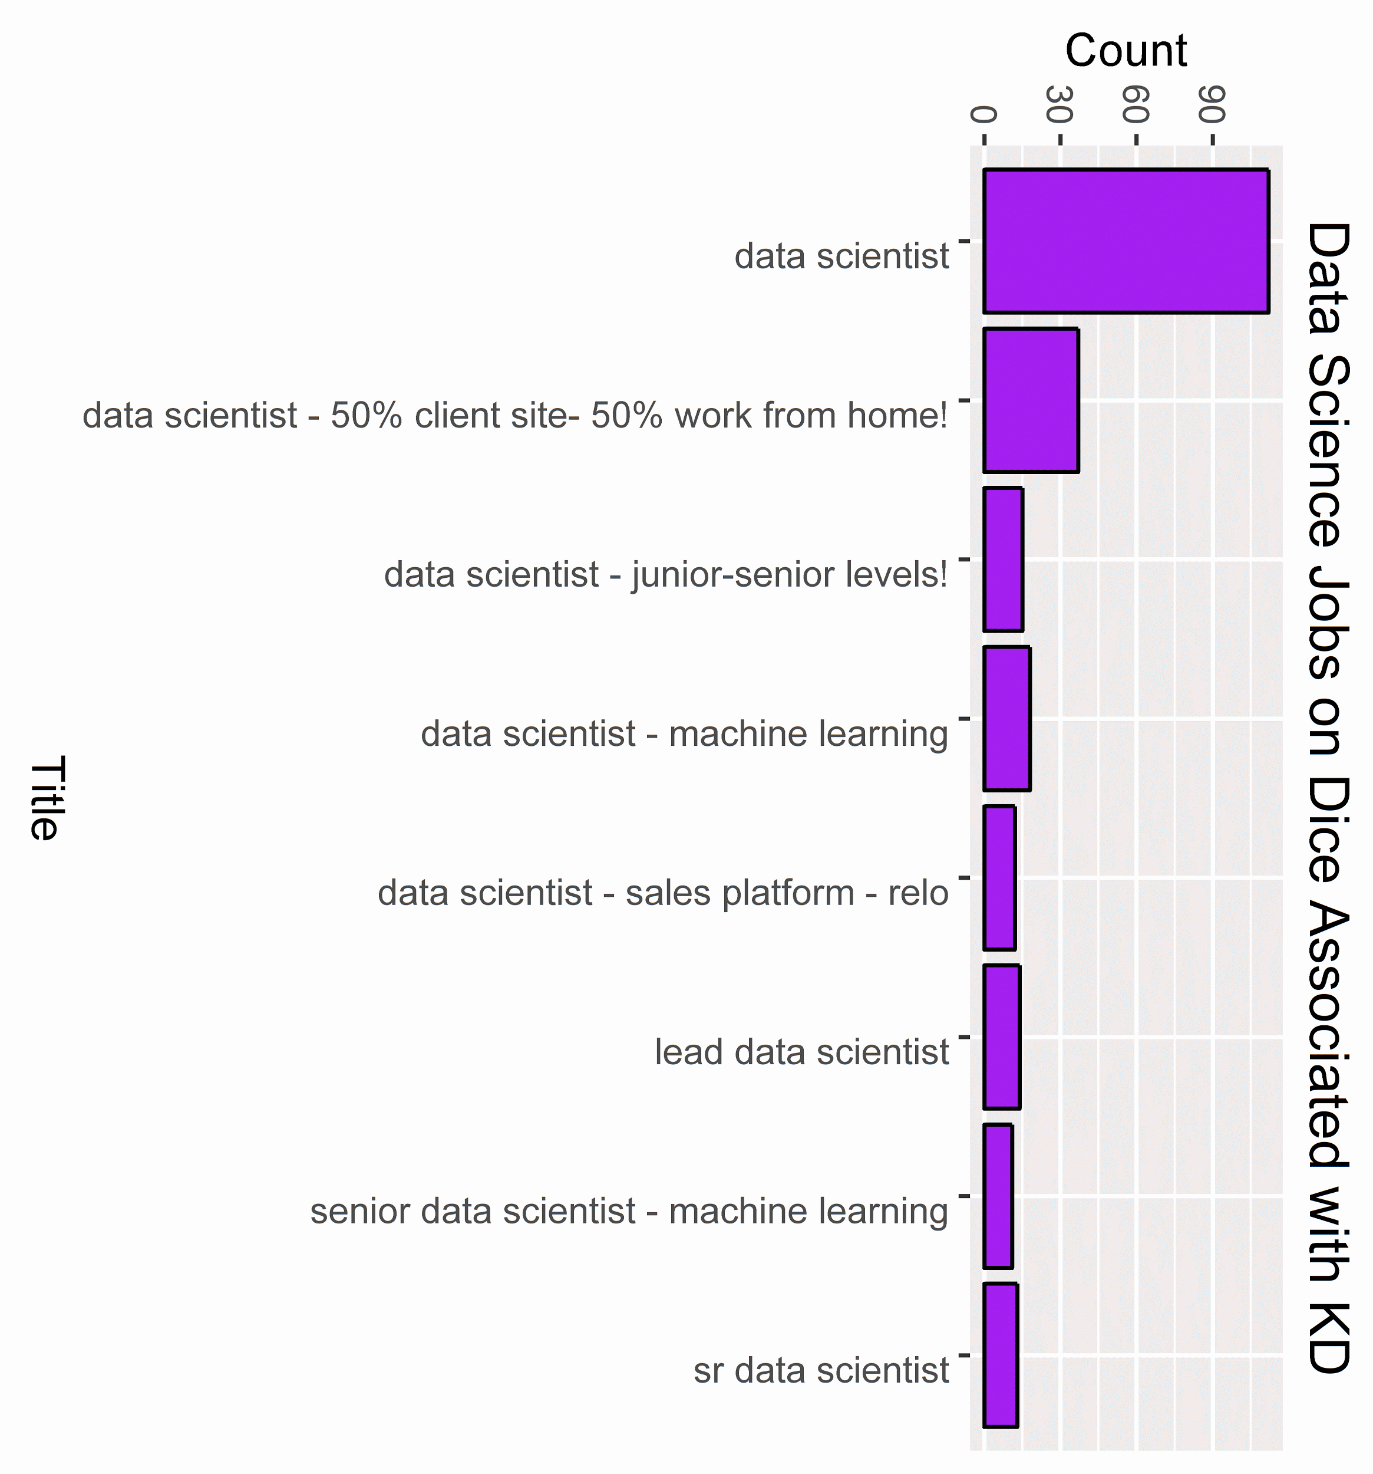
Data Analysis KD Nuggets
The skills identified in KD Nuggets were queried in DICE and we returned 50 jobs associated with each skill.
Data Scientist returns at a relatively high rate on this query 2.4%.
Notes:
First chart: Top 20 jobs returned on KD Nuggets Dice Query
Second Chart: All jobs named Data Scientist

Slide 9
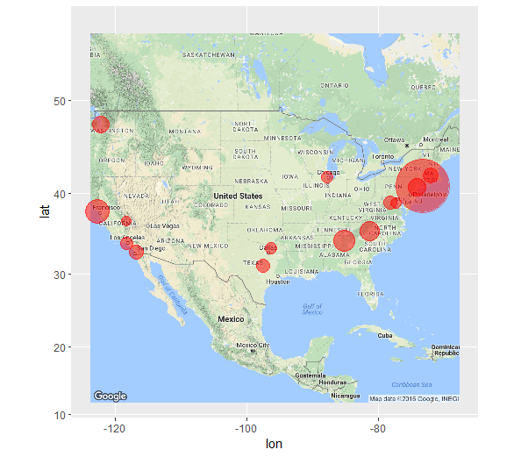
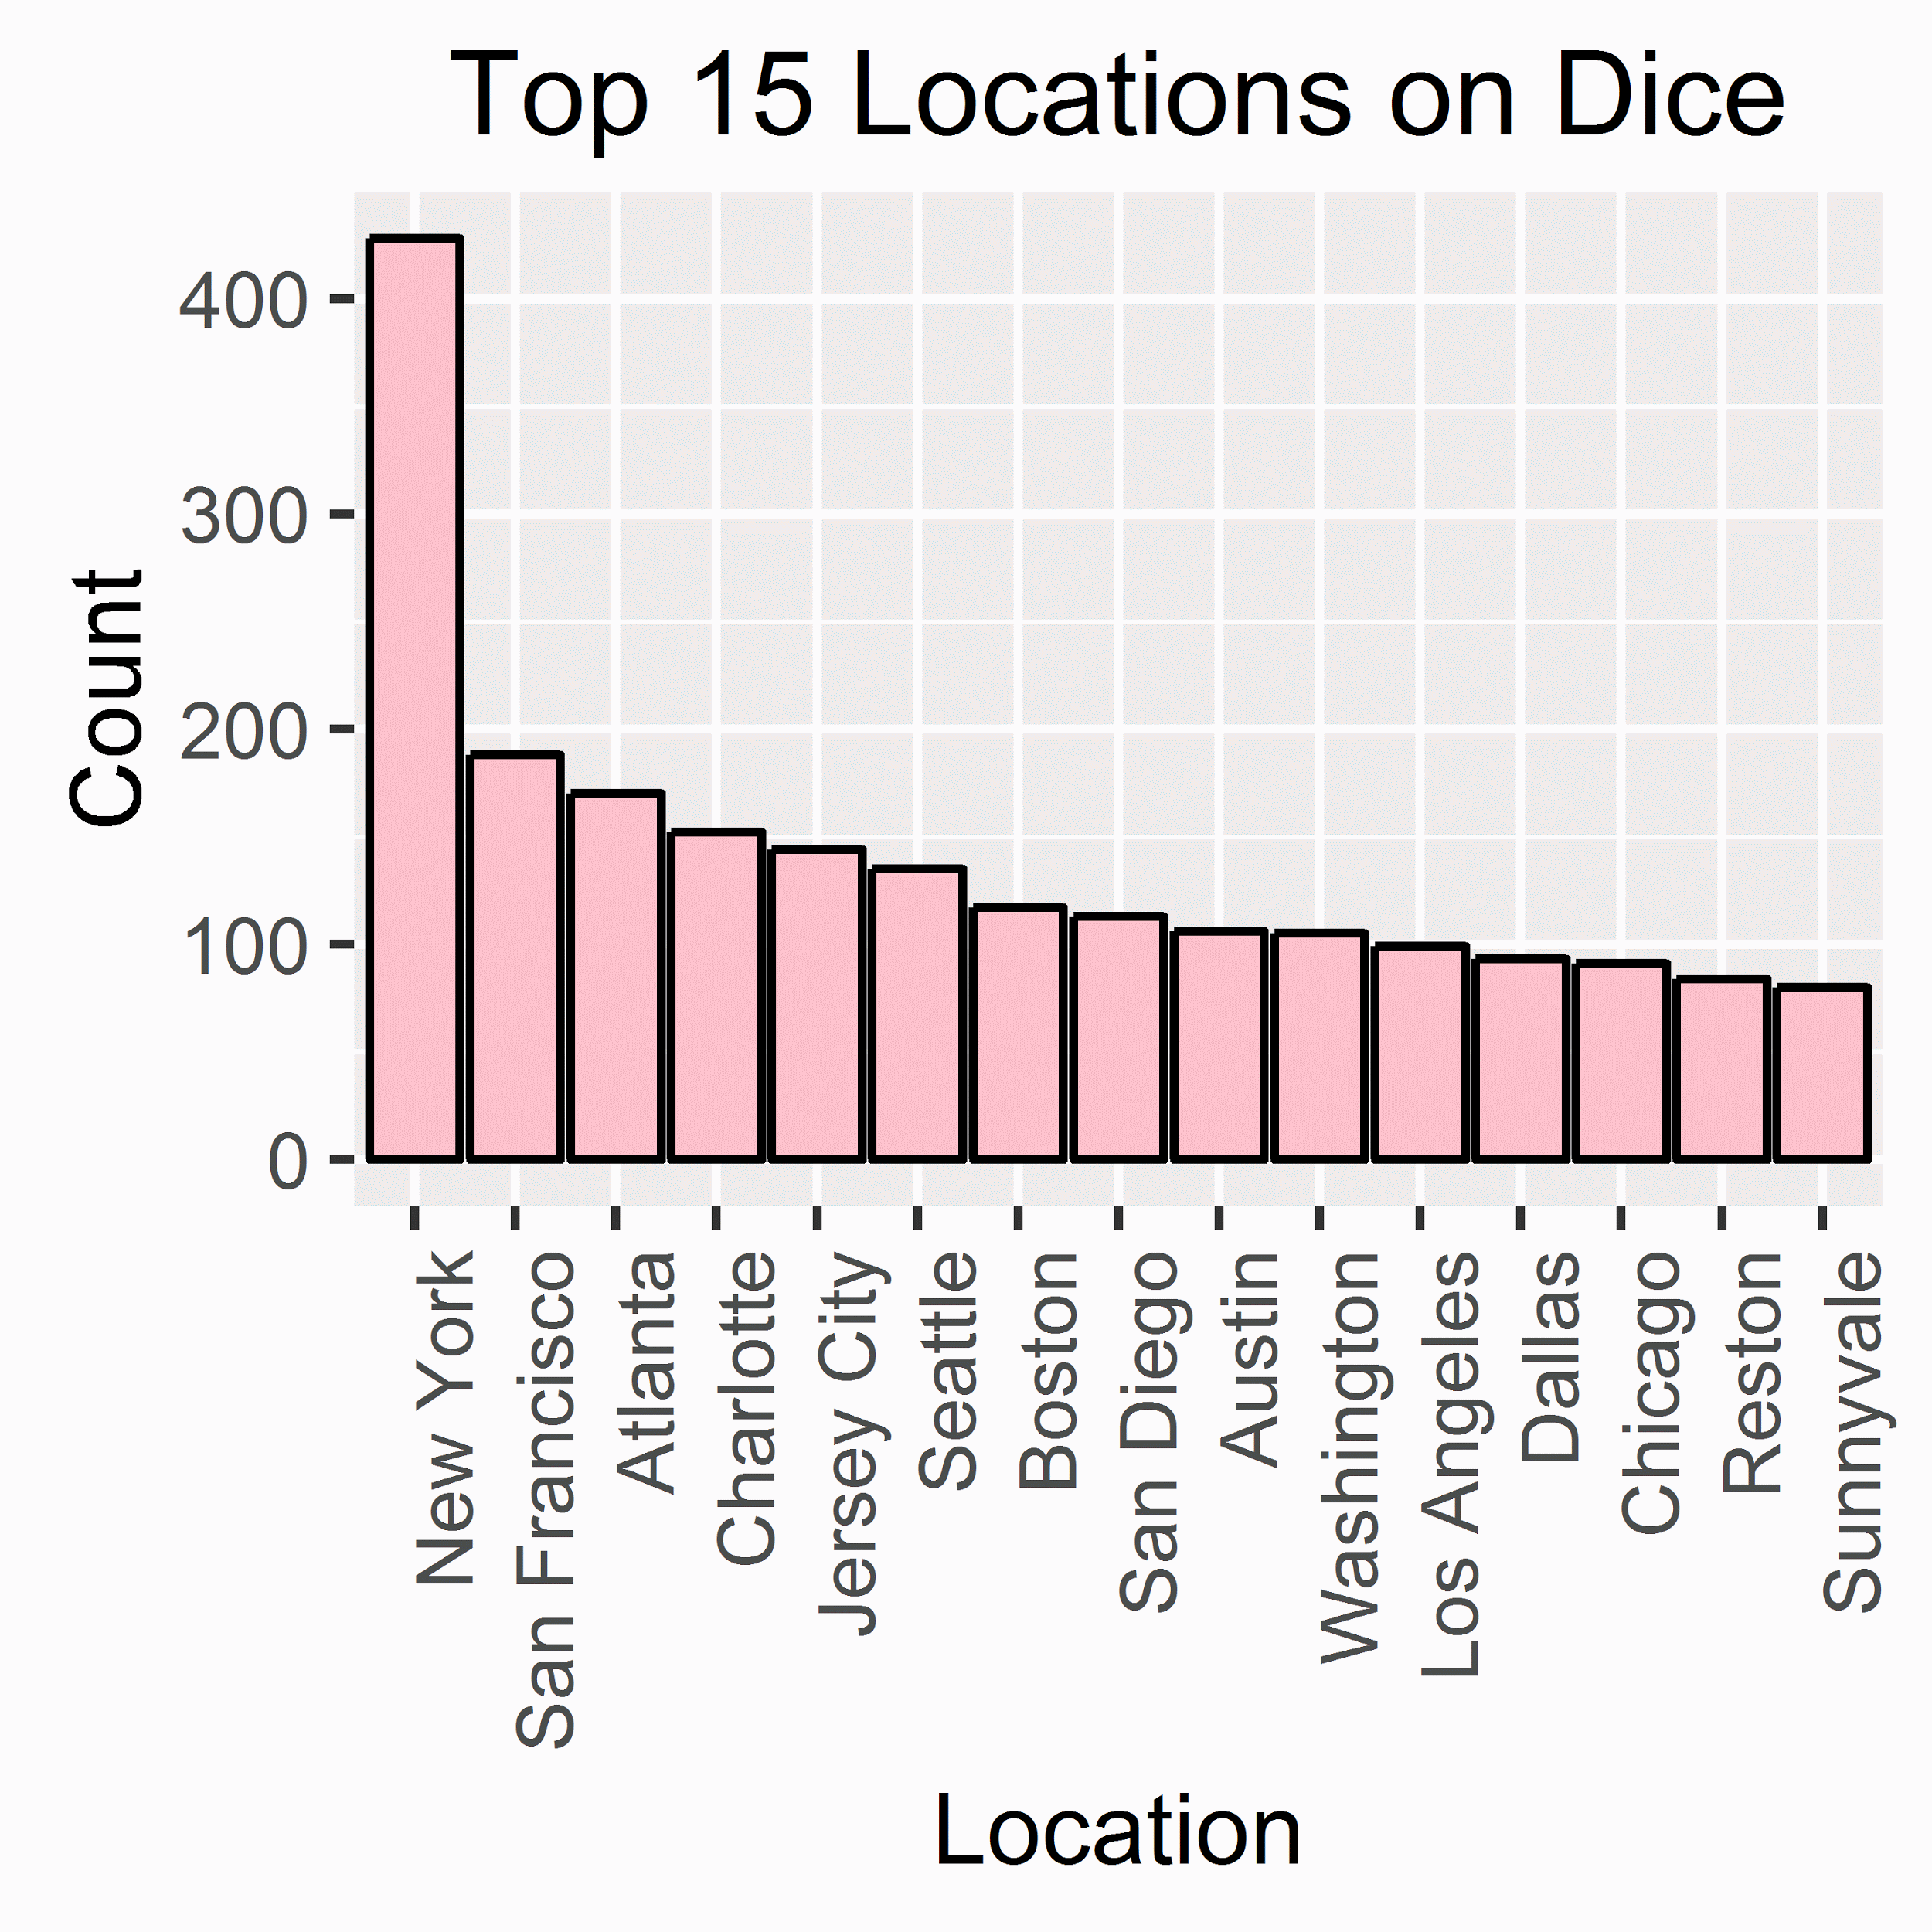
Data Analysis Location of DICE Query Jobs
New York is the leader followed
by San Francisco and Atlanta
Notes:
ggmap library creates this map after looking up latitude and longitude for each city
Only data science jobs

Slide 10
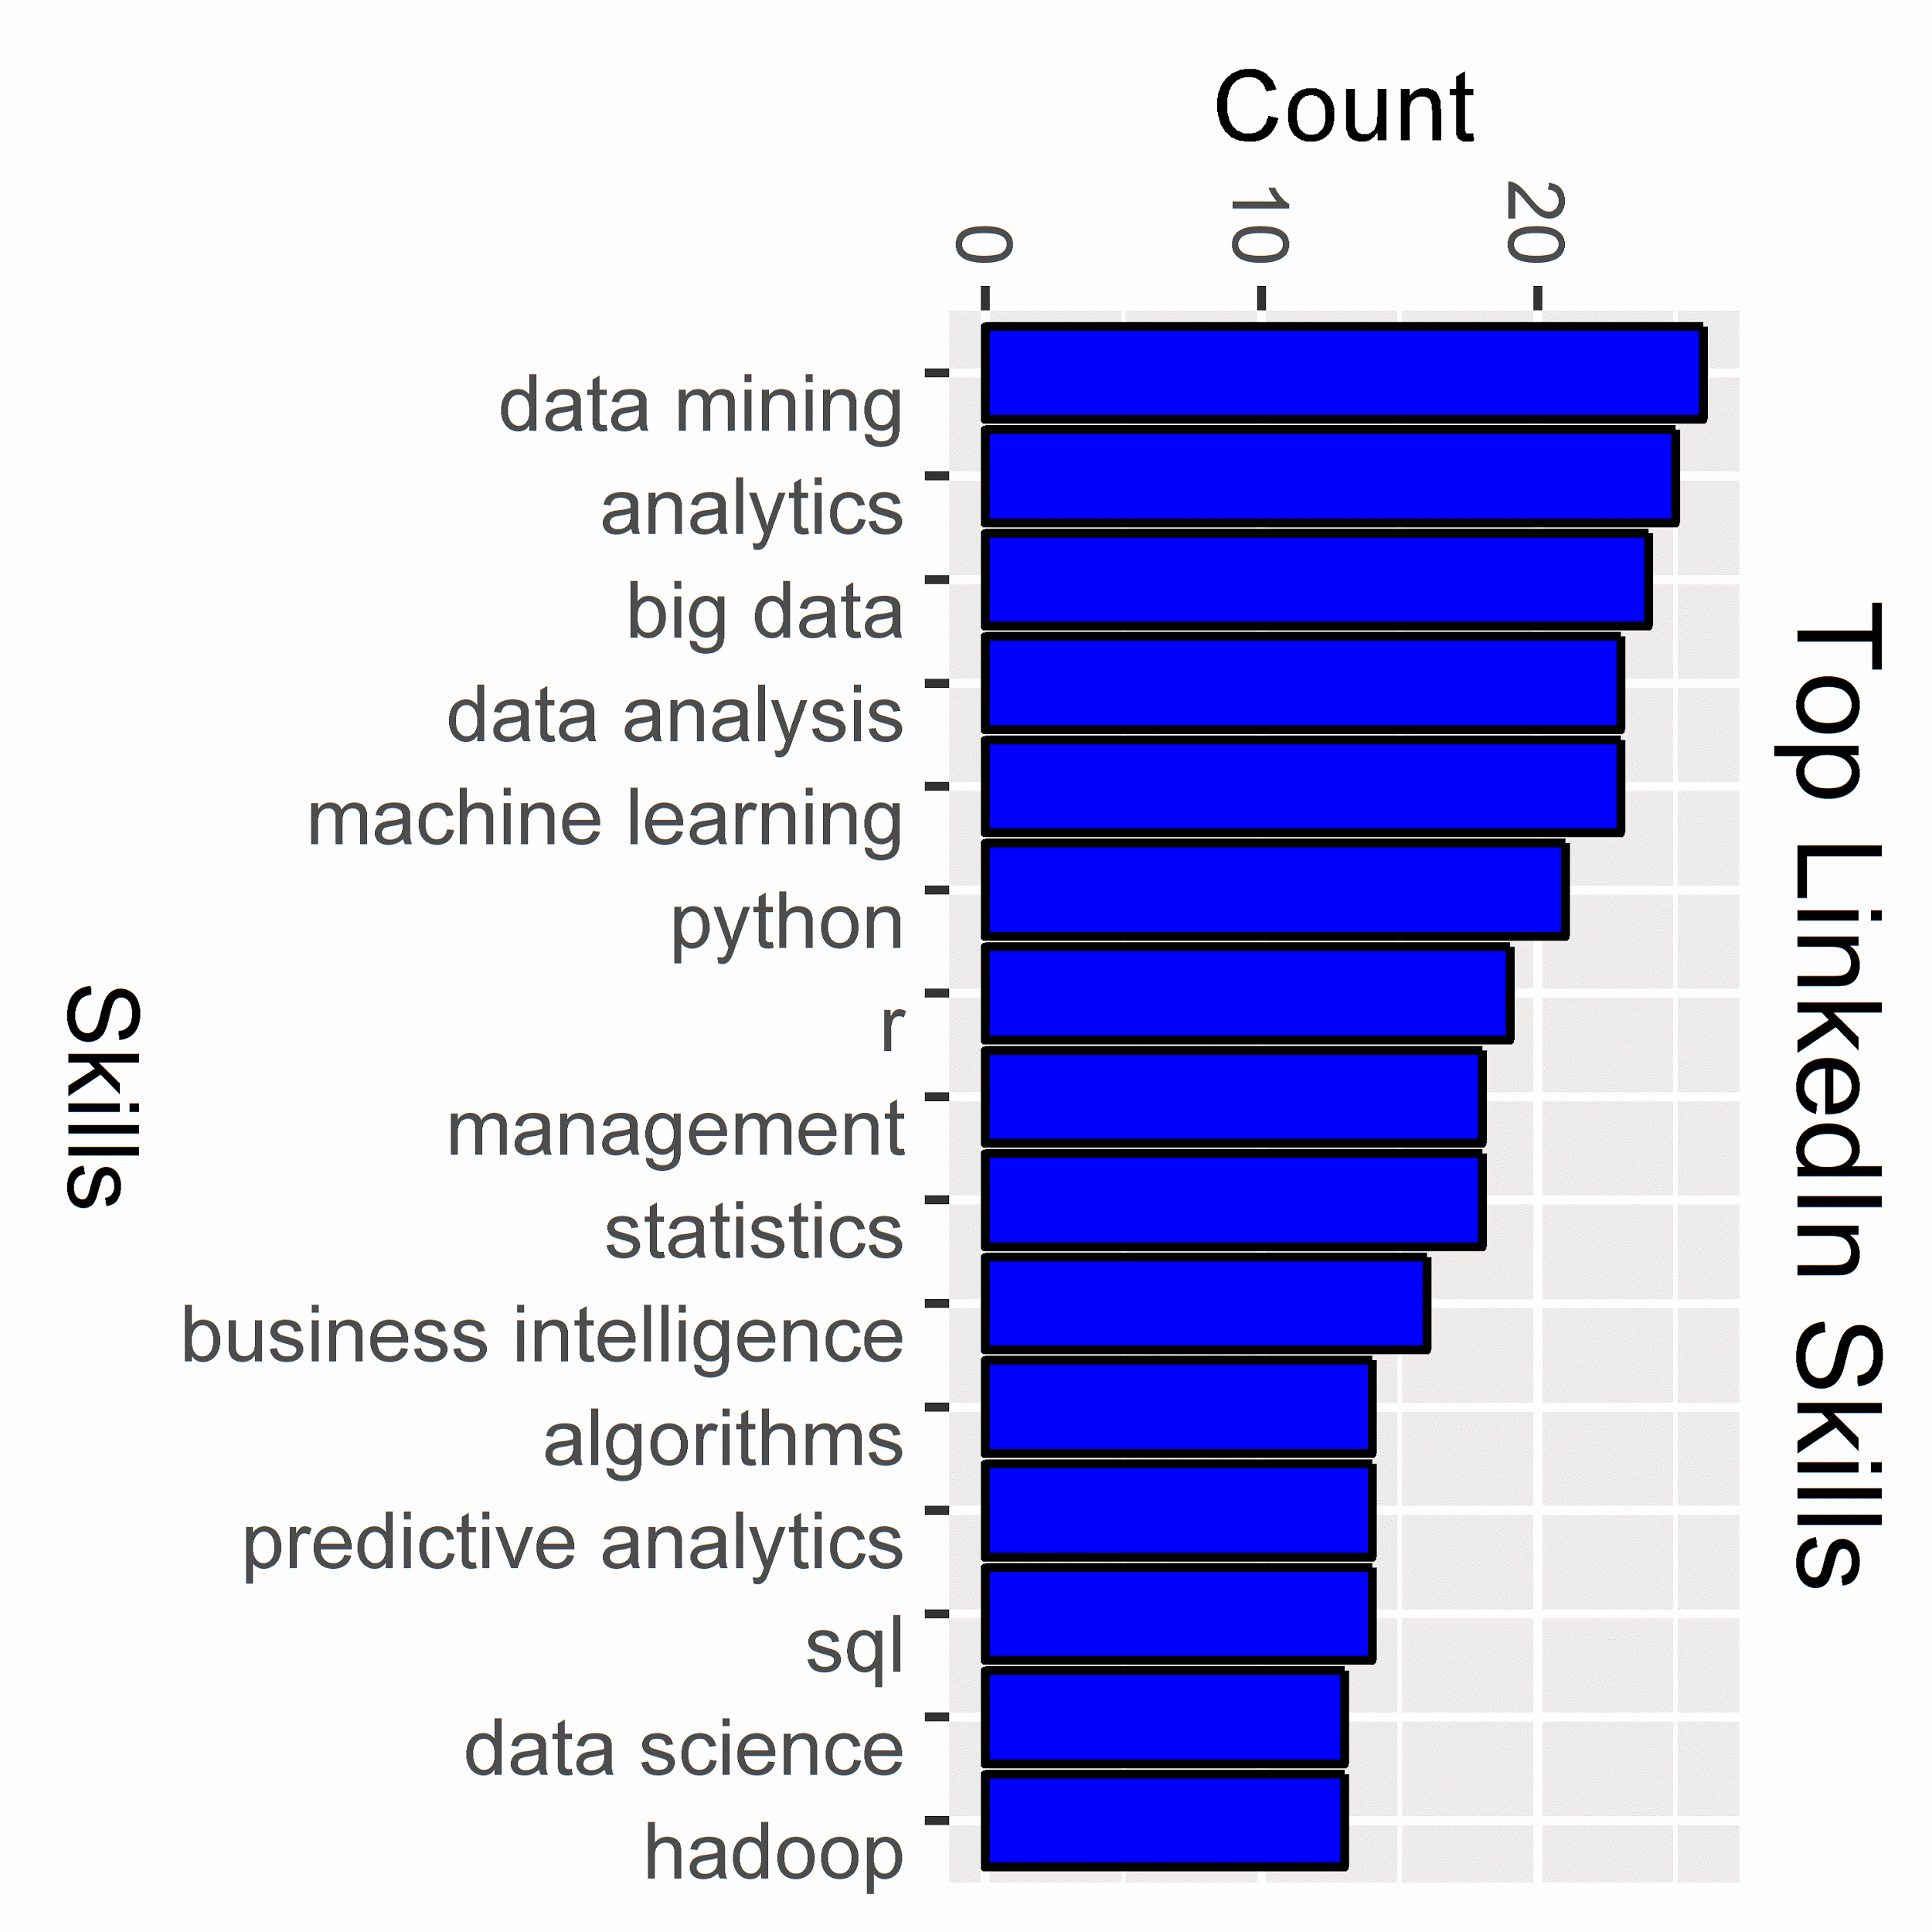
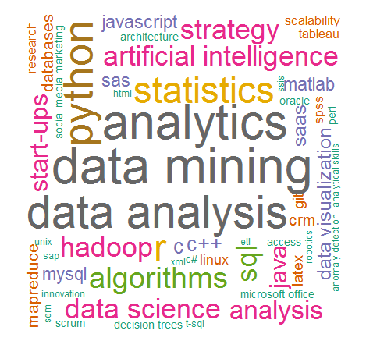
Data Analysis: LinkedIn Top Data Scientists
Skills of top data scientist profiles
Notes:
~650 Distinct skills for 26 people

Slide 11

Data Categories
Two categories of data skills were created, technical and non-technical.
Technical Non-technical
Programming (R, Python, …) Communication (presentation,..)
Stats/Math Management (project management, ..)
DataBase Soft skills (teamwork, collaborative,...)
Machine Learning Human resources (develop people,...)
Other (language, hobbies,...)

Slide 12
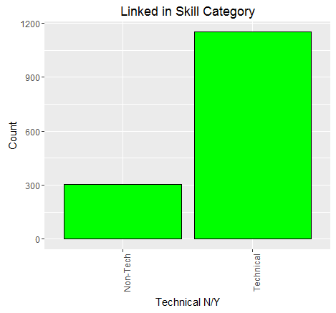
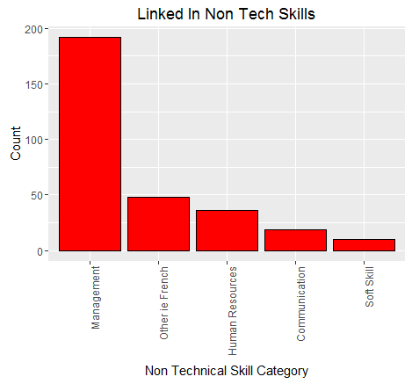
Data Analysis: Technical and Non-Technical Skills
Sub-stratify these skills into Technical or Non-Technical and then further stratify the Non-Technical Skills

Slide 13
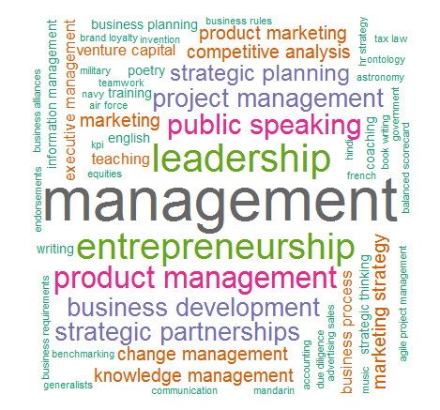
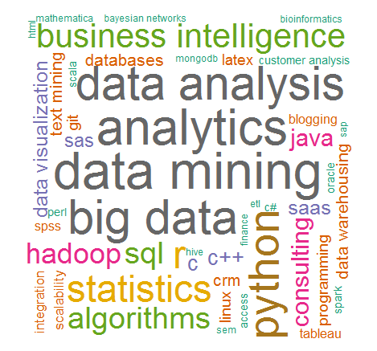
Data Analysis: Linked in Word Clouds
Non-Technical Skills Technical Skills

Slide 14
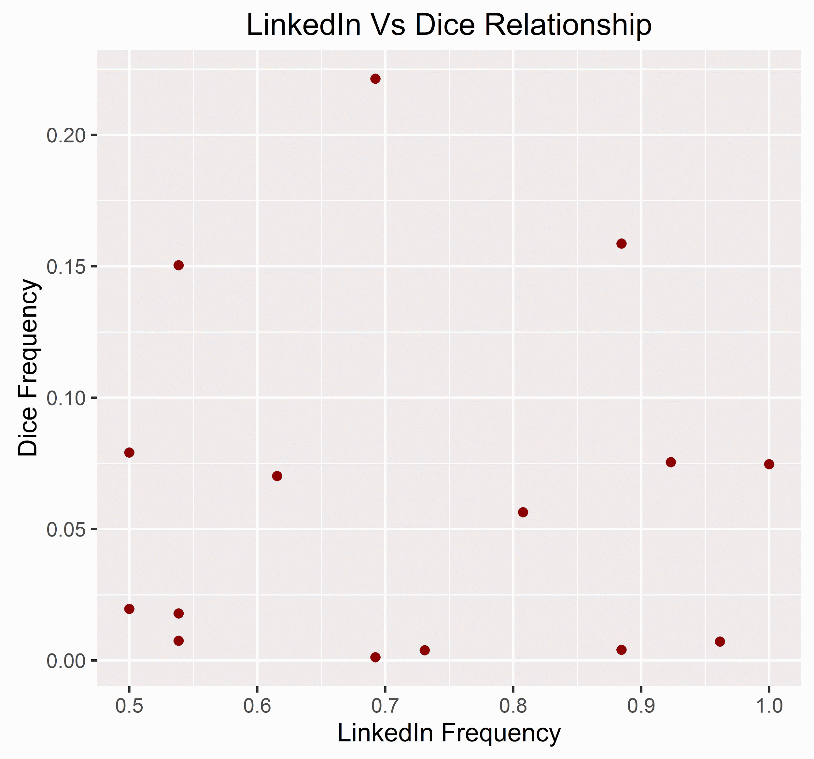
Data Analysis: LinkedIn Frequency vs DICE
Pearson=0.10
p-value=.46
No obvious relationship between the frequency of skills on the linked in top data scientists and the frequency of any job in the DICE database with that skill.
Notes:
Top 15 Skills
They are saying different things.

Slide 15
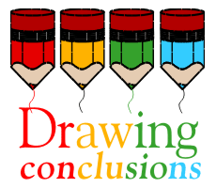
Findings
As expected, technical skills were found to be the most important data science skill
Technical Skills
Data-mining, analytics, machine learning and python seen as must-haves
Predictive analytics, artificial intelligence & algorithms more “value-added”
Non-Technical Skills
Amongst non-technical skills management is the most important followed by human resources and communication.
Soft skills is last in importance for data science, from four.

Slide 16

Retrospective
What went well?
Teamwork; Respect/help each others; Went through forming–storming–norming–performing within one week, MySQL connection in R!
What went wrong?
Same Codes do not run on 32-bit machine; (Real life example) Bug was found; need to rerun the analysis. Few time to planning, definitions and important settings are going according to the project progress. Code Integration
What were the obstacles?
Time constraint;

Slide 17

Future Research Steps and Spin-off Ideas
Build a more robust profile (or index) of successful data science skills taking into account
job tenure
seniority
coverage in the press / visibility
What skills are needed for data scientists to go on and start the next uber or amazon?
Build a profile modeler, how your profile match to a job post?

Slide 18

References
http://www.kdnuggets.com
https://www.linkedin.com
http://www.dice.com
https://github.com/IS607Project-3/Project-3-Data/tree/master

Slide 19


Q & A

